Slide 1
SMART MICROGRID USING FACE AUTHENTICATION SYSTEM
CSE7101- Capstone Project
Review-1
Batch Number: CSE_143
Under the Supervision of,
Ms. Swetha Rajagopal
Assistant Professor
School of Computer Science and Engineering
Presidency University
Roll Number | Student Name
20221CSE0216 | Y R Rahul
20221CSE0231 | Darshan Kumar C
20221CSE0242 | J Monesh
Name of the Program: CSE
Name of the HoD: Dr. Blessed Prince
Name of the Program Project Coordinator: Dr. Muthuraju V
Name of the School Project Coordinators: Dr. Sampath A K , Dr. Geetha A

Slide 2
Problem Statement Number: PSCS_15
Organization: Presidency University
Category (Hardware / Software / Both) : Both
Problem Description:
Design and implement a smart microgrid using face authentication system
ensure secure, resilient, and efficient operation under unauthorized access.

Slide 3
Content
> Problem Statement:
Design and implement a smart microgrid with face authentication to ensure secure, uninterrupted energy supply by:
Monitoring voltage, current & environmental conditions
Automatically switching between transformer & battery
Allowing only authenticated users to control loads
Enabling real-time remote operation via Bluetooth
> Objectives:
Automatic selection of best power source (Transformer / Battery)
Real-time monitoring of voltage, current, temperature, humidity
Load control using Bluetooth-based mobile app
Secure access using face authentication
Reliable and continuous power delivery
User-friendly display using LCD (I2C)

Slide 4
Content (continuation)..
> Background and Related Work for Title Selection
Traditional grids face failures, losses & manual switching issues
Smart microgrids improve reliability & autonomy
IoT enables automation, sensing & intelligent decision-making
Existing systems lack biometric security + low-cost automation
> Literature Review (Summary)
Key Insights from Reviewed Papers:
IoT-based microgrids require intelligent control & real-time data monitoring.
Sensor-based load management improves energy efficiency.
Bluetooth/Wi-Fi are reliable for local device communication.
Face authentication improves security but must be optimized for low-cost hardware.
Many prototypes lack combined power automation + security + monitoring.

Slide 5
Analysis of Problem Statement
Technology Stack Components:
Arduino Nano
Voltage Sensor Modules
ACS712 Current Sensor
DHT11 Sensor
HC-05 Bluetooth
2-Channel & 4-Channel Relays
12V Transformer
12V Li-ion Battery
Fan, LED, USB Load

Slide 6
Github Link
The Github link provided should have public access permission.
Github Link
https://github.com/Rahu245/Design-of-Cyber-Security-Enabled-Smart-Controller-for-grid-connected-Microgrid

Slide 7
Analysis of Problem Statement (contd...)
Software and Hardware Requirements:
Hardware Components
Arduino Nano, Voltage Sensors, ACS712 Current Sensor, DHT11 Sensor, HC-05 Bluetooth Module, ESP32-CAM (Face Authentication Module), 2-Channel Relay Module, 4-Channel Relay Module, 12V Transformer, 12V Li-ion Battery, 16×2 I2C LCD Display, Fan, LED, USB Port,Jumper Wires, Power Supply Unit.
Software Components
Arduino IDE, Embedded C/Arduino Language, LiquidCrystal_I2C Library, DHT Library, Serial Communication Library, Python with OpenCV, Mobile Bluetooth Application.

Slide 8
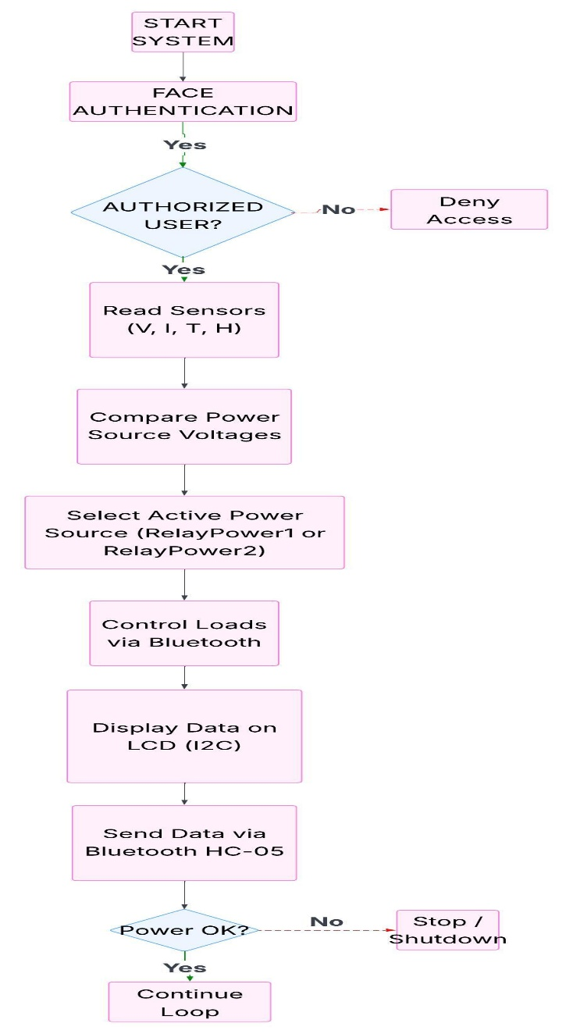
Analysis of Problem Statement (contd...)
Flowchart

Slide 9

Timeline of the Project (Gantt Chart)
Gantt Chart-

Slide 10
References (IEEE Paper format)
[1] S. E. Eyimaya and N. Altin, “Review of energy management systems in microgrids,” Applied Sciences, vol. 14, no. 3, Art. no. 1249, Feb. 2024, doi: 10.3390/app14031249. [2] M. R. Khan, A. B. Siddiqui, A. U. Rehman, J. Khan, M. T. S. A. Asad, and A. Asad, “IoT based power monitoring system for smart grid applications,” Processes, vol. 12, no. 2, Art. no. 270, Feb. 2024, doi: 10.3390/pr12020270. [3] R. A. Ahmed, M. M. F. Abdelraouf, S. A. Elsaid, M. ElAffendi, A. A. A. El-Latif, A. A. Shaalan, and A. A. Ateya, “Internet of Things-Based Robust Green Smart Grid,” Computers, vol. 13, no. 7, Art. no. 169, Jul. 2024, doi: 10.3390/computers13070169.

Slide 11


